Slide 1
College Information Night

Slide 2
College Types
Public
Oregon State University
University of Oregon
Portland State
Community College
Portland Community College – 2 year
Private
George Fox University
Pacific University

Slide 3
Considerations for Choosing a College
Major and Minors Offered
Cost
Location of Campus (setting and distance)
Size of School and Classes
Housing
Activities – Sports, Music, Clubs
Graduation Rate
Internship/Job Placement Services

Slide 4
Career and College Research
Naviance Career Cluster - recommends possible career matches based off of student interests
Naviance Supermatch - recommends colleges based off of inputted characteristics (degree, location, size of school, activities, etc)

Slide 5
Visiting A College
Housing options
Proximity of dorms to classes and local businesses
Food service
Availability of classes
Advising assistance
Availability of teaching staff
Academic help
Social life

Slide 6
College Visits
Tualatin High College Visits
10/7: University of Utah
10/11: Linfield University & Binghamton University
10/13: Savannah College of Art & Design, University of Oregon, Northern Arizona University, University of San Francisco, Northwestern University
10/14: Eastern Oregon University
College Visits Days
OSU - 10/8 (Sat), 10-14 (Fri), 11/5 (Sat) 11/18 (Fri)
Western Oregon - 10/14 (Fri, 10/28 (Fri), 11/18 (Fri), 11/19 (Sat)
PSU - 10/14 (Fri), 10/22 (Sat)
George Fox - 10/28 (Fri)
Pacific University - 10/7, 10/14, 11/4, 11/5, 11/10, 11/18, 12/2, 12/9
Portland Community College - 10/21, 12/2
College Fairs - PNACAC: Sun, Oct 9 from 12:00 - 3:30 pm and Mon, Oct 10th from 9:00am - 12:00pm, DoubleTree by Hilton, Portland
Independent College Visits

Slide 7
Colleges Consider Student’s
GPA
ACT/SAT Scores (possibly)
Application Essays
High School Activities
Volunteer Work
Work Experience

Slide 8
ACT/SAT Scoes
Test Optional
College Admission Trend
Optional to submit scores
Application decision vs Scholarships
Test Blind

Slide 9
College Application Timelines
Early Decision – receive response from college early, binding decision
Early Action – receive response from college early, not binding
Typically late October/early November
Regular Decision
Typically mid January to early February
Regular Acceptance Decision - May
Final Application Deadline - August

Slide 10
Local College Deadlines
Oregon State, University of Oregon
Early Action: November 1
Regular Deadline: January 15
University of Portland
Priority Deadline: November 15
Western Oregon, Portland State University, Portland Community College: Rolling admissions

Slide 11
Typical College Costs
 | Tuition | Housing | Out of State | Total
Portland State University | $10,081 | $13,500 |  | $23,581
Oregon State University | $12,444 | $13,860 |  | $26,304
Portland Community College | $5,700 |  |  | $5,700
George Fox University | $37, 840 | $12,700 |  | $50,540
University of Washington | $11,745 | $13,887 | $39,114 | $53,001
University of Oregon | $14,421 | $13,509 |  | $27,930
*Use Net Calculator on College Websites to determine approximate costs

Slide 12
Common App
One application for over 800 colleges
Not used by all colleges
Includes data on GPA, sports, clubs, work, service, transcript
Includes reference letters and counselor recommendation

Slide 13
What’s Needed for College Applications
Transcript(s) – High School and College Work
Application Essay
Letters of Recommendation
ACT or SAT Scores
Register on ACT.org to send scores
ACT # found on mailed test score or Counseling
Use same email address entered on test

Slide 14
College Essays
Admissions counselors say that the best essays help them learn something about the candidate that they would never know from reading the rest of the application.
Colleges and Scholarship Committees Look For
Positive qualities and values
dedication, focus, persistence, ambition, vision, leadership, team skills, energy…
Where you have made your impact
What you have learned
Where you have grown
Intellect

Slide 15
Financing College

Slide 16
Types of Financial Aid
Federal Grants & Student Loans
Oregon State Grants
College Funded Scholarships
Military Scholarships
Private Scholarships by Companies, Families, and Organizations
Private Loans

Slide 17
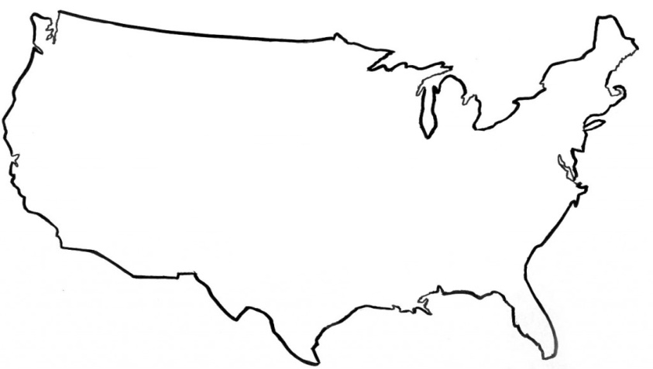
FAFSA and ORSAA
Complete FAFSA or ORSAA
FAFSA - Free Application for Federal Student Aid
For Students who are US Citizens and Documented Residents
Federal Grants and Loans
ORSAA – Oregon Student Aid Application
For Students who are Undocumented
FAFSA and ORSAA
Application Dates: Opens 10-1-2021
Fill out every year of college
Not mandatory to complete

Slide 18
Steps to Completing FAFSA/ORSAA
Online Application
FAFSA - https://fafsa.gov
ORSAA – https://oregonstudentaid.gov/fafsa-orsaa.aspx
Create Account
FAFSA ID - Student and Parent
ORSAA – Student only
Student Demographic Data
Address
Birthdate
Social Security Number or Alien Registration Number – FAFSA only
Identify college(s) student is considering

Slide 19
Steps to Completing FAFSA/ORSAA
Student’s Dependency Status
Student is declared independent if they are:
Over age 24 years old
Married
Provides 50% of support to a dependent child
In the Military or is a Veteran
An orphan
Homeless
If student is independent from parents
Can get unsubsidized loan
Work with college Financial Aid Office

Slide 20
Steps to Completing FAFSA/ORSAA
Parents Demographic Data
Who is parent for FAFSA purposes?
Parents are married or living together – report income of both parents
Parents are divorced or separated – report for parent student lives with majority of the time
Spend equal time with divorced or separated parents – report for parent who provides more financial support
If parent is remarried – have to also provide step parent financial information

Slide 21
Steps to Completing FAFSA/ORSAA
Parent Demographic Information (continued)
If student lives with other relatives (aunt, uncle, grandparents, sister, brother) they are not considered parents unless the student was legally adopted.
If parents are not US Citizens and do not have Permanent Resident Card, enter 000-00-000 for Social Security Number

Slide 22
Steps to Completing FAFSA/ORSAA
Financial information
Report for Student and Parents
2021 US Tax Forms (ex. IRS Form 1040) or IRS Retrieval Tool
Reporting assets:
Money in cash, savings, checking accounts
Real estate other than your primary home
Investments such as stock, bonds, mutual funds
529 College Savings Plans
Don’t have to report retirement savings
Doesn’t consider debt
May need to file taxes if haven’t already done so

Slide 23
Steps to Completing FAFSA/ORSAA
Work Study Opportunity
Sign and Submit the Application
Both Student and Parent must sign
FAFSA - If parents are not US Citizens or have Permanent Resident Card, will need to sign paper copy and send via mail
ORSAA – Sign electronically with email address

Slide 24
FAFSA Results
EFC – Estimated Family Contribution
Measure of family financial strength.
Considers your assets, family size and number of family members in college
Example
EFC 00000 – family expected to contribute $0 to college
EFC 05000 – family expected to contribute $5000 to college funds
Calculated assuming 5.64% of Parent’s Assets and 20% of Student’s Assets can be used for college
Cost of Attendance – to determine your financial need

Slide 25
FAFSA Results
Pell Grant – free money which does not need to be paid back
2022 Maximum Pell Grant $6,895
Subsidized Stafford Loan
Department of Education pays interest while student is in college
Borrow $3500, owe $3500 at graduation
Maximum amount 1st year dependent student is $3500. Increases for future years
2021 Interest rate 3.73%
Loan fees (1.057%) deducted from loaned amount
Unsubsidized Stafford Loan
Interest accrues immediately and is added to debt
(Borrow $3500, owe $3500 + interest for each year at graduation, at 6% interest would be $4418)
Maximum of $5500 between Subsidized and Unsubsidized Loans
2021 Interest rate 3.73%
Loan fees (1.057%) deducted from loaned amount
Direct/Parent Plus Loans – application based on credit score
2021 Interest rate 6.28%
Loan fees of 4.228 deducted from loaned amount

Slide 26
FAFSA and ORSAA Results
Oregon Opportunity Grant
Need based grant
2021 Maximum Award:
$3600 for Community College
$4692 for 4 Year University
US Citizens, Legal Residents, & Undocumented Students

Slide 27
FAFSA/ORSAA Miscellaneous
College Verification of Data
Income (copy of taxes or IRS Transcript)
Proof of citizenship
Proof of residency – Tuition Equity
Changing FAFSA Data
Is it important to fill out the FAFSA/ORSAA early?
What to do if your situation changes

Slide 28
CSS Profile
Used Primarily by Private Colleges
Requests more financial information such as medical bills, value of primary home, information from both parents if divorced
Considers regional living expenses
Cost $25 to submit
Deadline dependent on individual colleges

Slide 29
Government and College Grants and Scholarships

Slide 30
Oregon Promise
2 Year Community College Funding
Award of $1000 - $4131
Minimum 2.0 GPA
Live in Oregon 1 Year
Have to file FAFSA or ORSAA
Deadline – June 1, 2023
$50 co-pay per term
May consider family financial situation

Slide 31
Merit Scholarships
Specific to college
Scholarships for 1 to 4 years
Examples
OSU $1500 - $10,000/year
Gonzaga - $20,000/year
Apply through College Admission Application or Separate Scholarship Application
Typically dependent on maintaining GPA in college

Slide 32
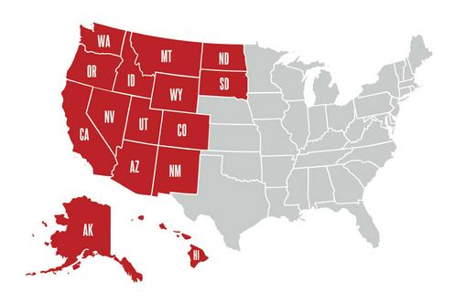
Western Undergraduate Exchange (WUE)
Non-resident discounts
Amounts and application process varies per college
Available at over 160 college in 16 Western states
States Include
Alaska New Mexico
Arizona North Dakota
California Oregon
Colorado South Dakota
Hawaii Utah
Idaho Washington
Montana Wyoming
Nevada US Pacific Territories

Slide 33
Oregon Universities Offering Free Tuition to Low Income Families
Portland State
Western Oregon University
University of Oregon
Oregon State University

Slide 34
College Specific Scholarships Requiring Additional Application
College Funded Scholarships
Western Oregon Bilingual Teacher Scholars Program
Oregon State Robotics Scholarship
University of Oregon Diversity Scholarship
PCC Foundation Scholarship
Portland State Four Years Free
Individual Donors
Application thru college application essays or separate application form
Western Oregon Bilingual Teacher Scholars Program
Oregon State Scholar Dollars
Oregon State Robotics Scholarship
University of Oregon Stamps Scholarship, Diversity Scholarship and Presidential Scholarship
PCC Foundation Scholarships
Portland State Scholarships

Slide 35
Military Scholarships
Military Academies
Reserve Officer Training Corps (ROTC)
Active Duty - Tuition Assistance and GI Bill
Reserve Duty – Tuition Assistance, housing, pay
Oregon National Guard – Tuition, housing, pay
4-8 Year Commitment to Military
Military Night
Monday, October 10th
6:30pm
Tualatin High Library

Slide 36
Financial Aid Packages
Come from Colleges not Federal Government
Includes:
Federal Pell Grants and Loan Opportunities
State Grants or Scholarships
College Merit and Donor Scholarships
Work Study
Military Scholarships
Student must accept each grant, loan or scholarship and identify if and how much they want to borrow

Slide 37
Scholarships

Slide 38
Private Scholarships
Scholarship May Focus on:
Financial Need
Grades/Test Scores
First in Family
Ethnicity
Service
Leadership
Field of Study
Creative Essays, Videos and Art Projects

Slide 39
What Students DON’T Need to Apply
Straight A’s
High ACT/SAT Scores
Decision on a college
US Citizenship

Slide 40
What You Will Likely Need
High School Transcript
Information on Your:
Volunteer Experience
Work Experience
Club & Sports Participation
Honors or Awards
Family Financial Information
Names of Adults to Write Recommendations

Slide 41
Tips for Winning Scholarships
Write interesting essays which tell your story
Check for grammar and mistakes
Have someone review application and essay
Choose recommendation writers carefully
Plan time in the spring for applications

Slide 42
Scholarship Realities
Big $ and National Scholarships
Time Commitment
Students Won’t Win Every Scholarship

Slide 43
Scholarships Spreadsheet
Due Date | Scholarship Name | Key Words | Amount | GPA | Website | Description | Applicant Area
10/8 | The Skanner Foundation Scholarship | Community service | $3,000 | 2.5 | https://www.theskanner.com/foundation/scholarship | Applicants must have completed at least 20 hours of volunteer service within the last year. | Regional
10/8 | AES Engineers Scholarship | Essay | $500 |  | http://www.aesengineers.com/scholarships.php | 500-1000 word essay: When you look back on your life in 30 years, what would it take for you to consider your life successful? What relationships or accomplishments will be important on this journey? | National
10/10 | Youth Senate Program | Student government leaders | $10,000 |  | https://www.oregon.gov/ode/students-and-family/Pages/United-States-Senate-Youth-Program.aspx?utm_medium=email&utm_source=govdelivery | Leaders in student government, education, public affairs or community service. Students must be nominated by school principal and will attend national conference. | Regional
On the Tualatin High School website, hover on the Counselor tab, select College and Career Center
On the Home Page, select the Colleges tab
From the drop down menu, select Paying for College, then Scholarships
Select the grey box: Scholarship List
A Google Sheet spreadsheet will appear

Slide 44
Finding Scholarship Opportunities
Internet Search on Scholarship Databases
Clubs and Groups
Parents or Your Place of Employment
Naviance

Slide 45
State of Oregon Scholarships and Grants
OSAC Scholarships
Office of Student Access and Completion
www.oregonstudentaid.gov
One application
Over 600 scholarships
Opens November 1st
Early Bird Deadline – Feb. 15, 2022
Deadline – March 1, 2022

Slide 46
Local Scholarships
LAM Research Core Values Scholarship
Foundation for Tigard Tualatin Scholarships
TSO Scholarship
Tualatin Science & Technology Scholarship
Tualatin Historical Society Scholarship
Tualatin Soccer Scholarship
King City Lions Club Scholarships (through OSAC)
Express Employment Professional Scholarship
Tigard Chamber Scholarship
Byrom Elementary Scholarship
Alberta Rider Elementary Scholarship
TTSD Superintendent Scholarship
TTEA Scholarship
Architecture, Construction and Engineering (ACE) Scholarship
Hispanic Metropolitan Chamber Scholarship
Wilberding Family Scholarship
Tualatin Alumni Scholarship
Reser Family Foundation Scholarship
ACT Six – George Fox and Warner Pacific
Black United Fund of Oregon
Linfield, UP, Pacific, Willamette, Concordia, Reed, Lewis & Clark
WashCo Diverse Educator Pathway Program – Western Oregon

Slide 47
How can Freshman, Sophomores, and Juniors Be Doing Now to Plan for College?
Research Careers of Interest
Research Colleges of Interest
Get involved in Sports and Clubs
Volunteer in Community
Consider internship opportunities
Record activities and volunteer experience
Maintain or improve GPA
Plan to visit colleges before the student’s senior year

Slide 48
What Should Seniors Be Doing Now?
Identify colleges to apply to
Identify Individuals for Letters of Recommendation
Work on college essay
Start Applying to Colleges of Interest
Stay focused on classes and GPA
Identify and apply to scholarships

Slide 49
Decision Day - May 1
Accept entrance to college of choice
Pay deposit

Slide 50
Next Steps for College
Accept scholarships
Accept loans
Apply to housing
Orientation/register for classes

Slide 51
You might be thinking:
FAFSA sounds overwhelming
My child has no idea what they want to do when they graduate
My senior hasn’t started applying to college
My senior is struggling with their college essay
I can’t afford college
Don’t worry, We can help you!

Slide 52
Tualatin High Contacts
College and Career Center
Kathy Stallkamp Jennifer Butts
kstallkamp@ttsd.k12.or.us JButts@ttsd.k12.or.us
503-431-5652 503-431-5772
Counselors
Teresa Kaufman Last Names Starting with A-Col tkaufman@ttsd.12.or.us
Kat Toms Last Names Starting with Com- Gre ktoms@ttsd.12.or.us
Jazmin Chavez Last Names Starting with Gri –Lh jchavez@ttsd.12.or.us
Christie Langer Last Names Starting with Li – N clanger@ttsd.12.or.us
Holly Poulivaati Last Names Starting with O-Sha hpoulivaati@ttsd.12.or.us
Jen Woebke Last Names Starting with She - Z jwoebke@ttsd.12.or.us
Presentation slides available on TuHS Website under College and Career Center
Under Counseling Tab

